Slide 1
Part I

Slide 2

An introduction to modelling natural systems
Shane Blowes
German Centre for Integrative Biodiversity Research,
Martin Luther University
shane.blowes@idiv.de

Slide 3
Outline
Introduction: examples
Models and the Scientific Method
What are models?
Types and uses of models

Slide 5
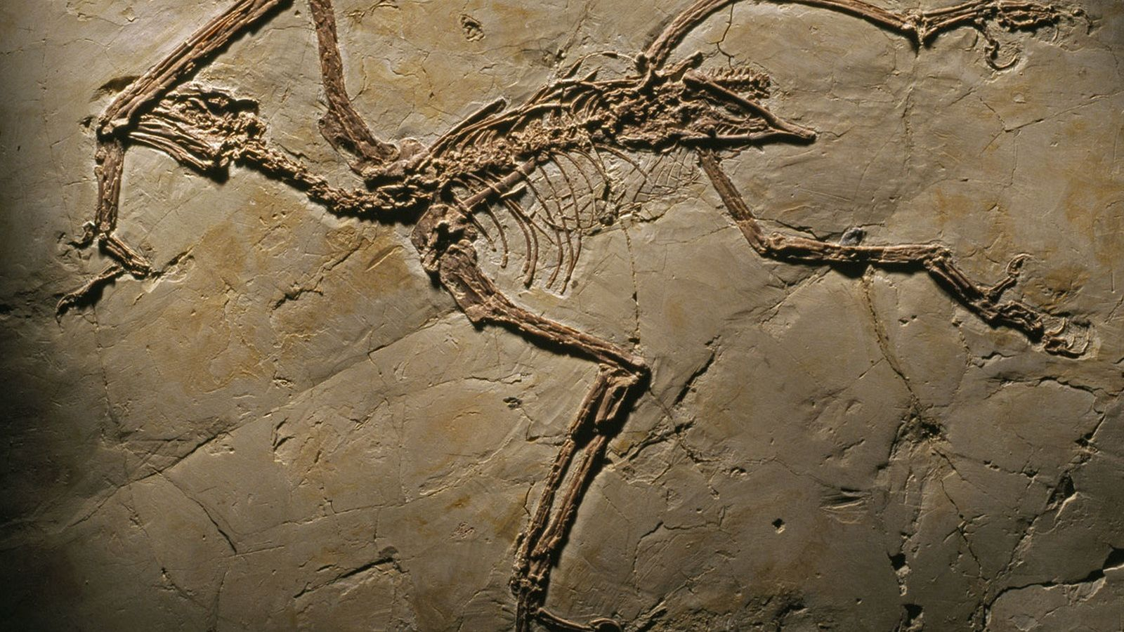
Scientific Method
Observation of a pattern (description)
Propose explanation (how or why)
Make prediction
Prediction ‘falsified’:
reject explanation
Conduct experiment
Prediction ‘verified’:
retain explanation
Interpretation
Carey 2004 A beginner’s guide to the Scientific Method

Slide 6
Where does modelling
fit in?
Observation of a pattern (description)
Propose explanation (how or why)
Deriving explanations & predictions from scientific theory:
‘Theoretical modelling’
Make prediction
Confronting models with data:
Statistical analysis & visualisation:
‘Statistical modelling’
Conduct experiment
Interpretation

Slide 7
Modelling and Science
Science is a dialogue between
what’s really out there (observations)
what we are looking for (the conceptual framework we use to make sense of observations)
Requires good observations: experimental design
random sampling
systematic measurements
Being mindful of preconceptions: modelling
- specify clearly what assumptions are being made
rigorously deriving predictions from assumptions
using data to evaluate predictions

Slide 8
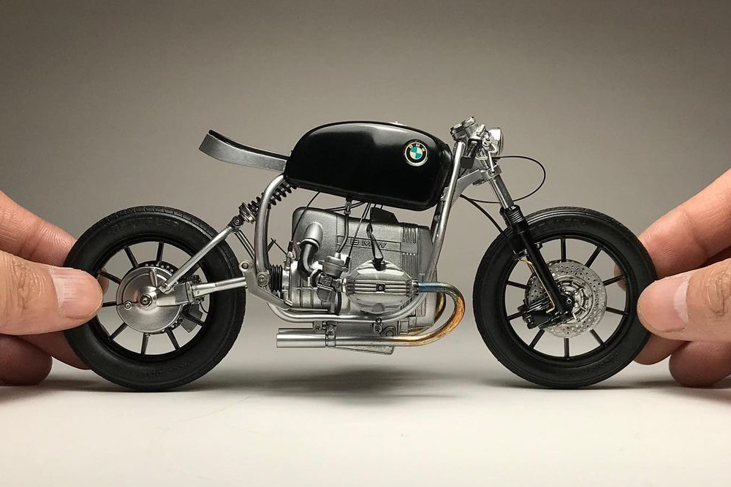
What are models?
A model is a set of assumptions about how something in the natural world works
Kinds of models
Conceptual (e.g., verbal or graphical) models
Scale models
Mathematical models
(including computer simulations)

Slide 9
What are models?
Nature’s complexity means all models must abstract and idealise to some degree
So, all models must be wrong
We don’t ‘test’ models, but we do test predictions from models (can also empirically examine model assumptions)
Use tests to inform model development
Or, to evaluate what phenomena the model can and cannot help us understand

Slide 10
A modelling decision tree
Do I want to…
…understand or predict the consequences of nature working a particular way?
…compare a model’s behaviour with patterns in empirical data?
THEORETICAL MODELLING
STATISTICAL MODELLING
Is my question…
Do I want to…
…describe patterns
in the data?
…evaluate a
process-based model?
Do both of these things simultaneously?
General
Specific

Slide 11
Different kinds of models
Process-based models
- represents a set of ideas about how nature works
- used in theoretical and statistical modelling
Descriptive model
- a mathematical formula proposed to ‘fit’ an observed pattern in nature
- only used in statistical modelling

Slide 12
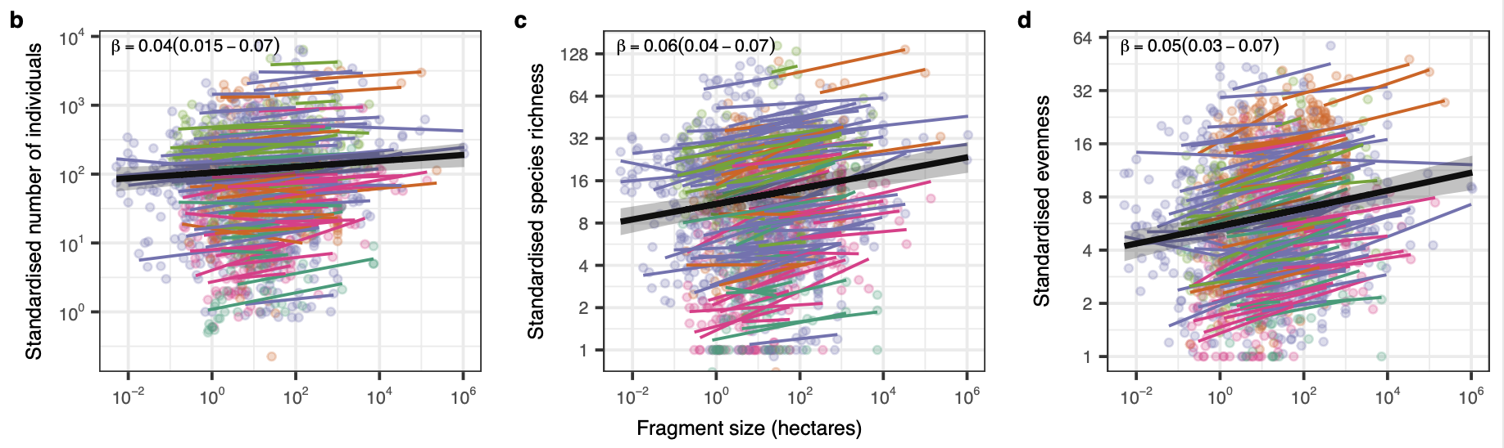
Examples
Theoretical modelling with a general model
- What is the optimal spacing for protected areas?
What are the consequences of altered biological processes (e.g., reduced connectivity, changes to competition for resources) for biodiversity?
Statistical modelling with a descriptive model
- How does diversity change with habitat fragment size?
Chase et al. 2020 Nature

Slide 13
The perfect model (what we want)
General
applies in a wide range of contexts
Realistic
incorporates all the important processes
Precise
- predicts what happens in nature closely
Simple
- interactions can be comprehensively understood

Slide 14
Imperfect models (what we work with)
Generality, realism, precision and simplicity all involve trade-offs
because nature is complex and variable
For important questions, use different models that make different trade-offs
“Our truth…is the intersection of independent lies.”
--Richard Levins (theoretical ecologist)

Slide 15
Break

Slide 16
Process-based models I
Part II

Slide 17
Modelling population growth
N_{t+1} = N_{t} + births + immigrants – deaths – emigrants
∆N = N_{t+1} - N_{t} = births + immigrants – deaths – emigrants
To start, we’ll assume immigration and emigration are negligible,
∆N = births – deaths

Slide 18
Modelling population growth
∆N = births – deaths
Divide each component of population growth into two parts:
(i) Per-capita contribution: each individual’s contribution to population growth
(ii) Population size: the total number of individuals contributing

Slide 19
Modelling population growth
∆N = births – deaths
Two-parts to modelling number of new recruits:
(i) Per-capita recruitment (b)
average number of new individuals next year for each individual in the population this year
includes fecundity and survival to age 1
(ii) Population size this year (N_{t})
Example: b = 3, N_{t} = 100

Slide 20

Modelling population growth
∆N = births – deaths
$$\text{births}\text{ = (}\text{per} \text{capita} \text{births}\text{) }\text{x}\text{ (}\text{population} \text{size}\text{)}$$
= b x N_{t}

Slide 21
Modelling mortality
∆N = births – deaths
Two-parts to modelling natural mortality:
(i) Per-capita mortality (d)
Fraction of population alive this year that dies before next year
Or, probability that individual alive this year dies before next year
(ii) Population size this year (N_{t})

Slide 22
Modelling population growth
∆N = births – deaths
= bN_{t} – dN_{t}
= (b – d)N_{t}
= RN_{t}
Two kinds of variables in dynamic models:
- state variables record the state of the system,
- parameters drive changes in the state variables

Slide 23
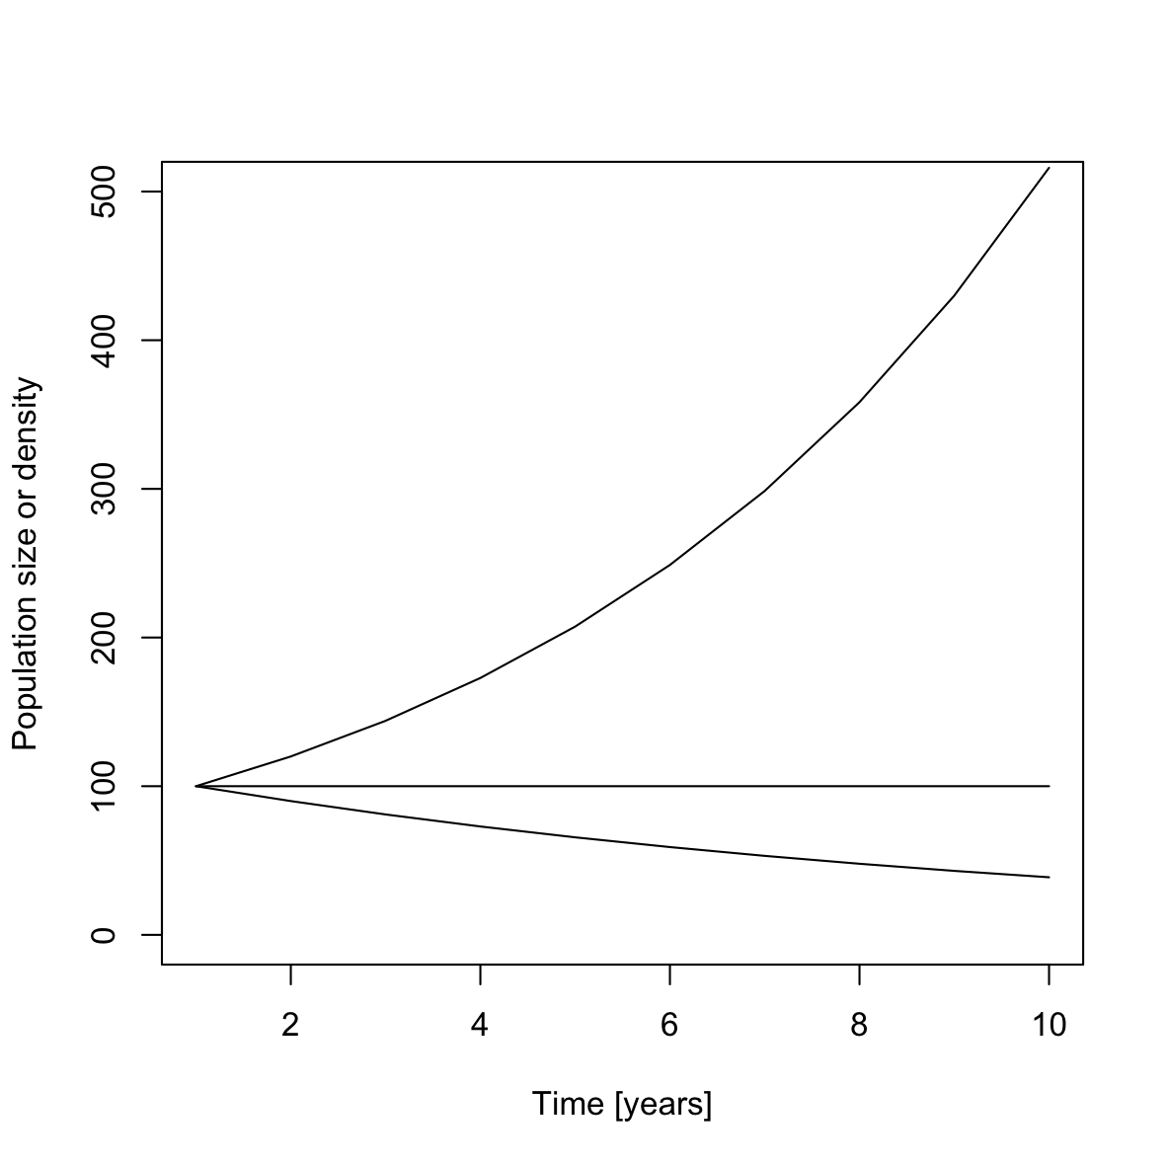
Geometric population growth
b > d
b = d
b < d

Slide 24
Computer exercises
Geometric population growth
Stochasticity

Slide 25
Break

Slide 26
Process-based models II
Part III

Slide 27
Metapopulations
Models of metapopulation dynamics:
Patch occupancy
Levins 1969 Bull Entomol Soc Am, Hanski 1988 Nature

Slide 28
Metapopulations
Models of metapopulation dynamics:
Patch occupancy
Metapopulation growth rate

Slide 29
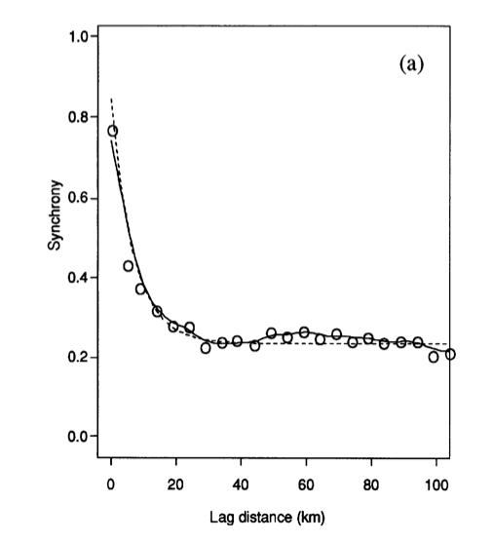
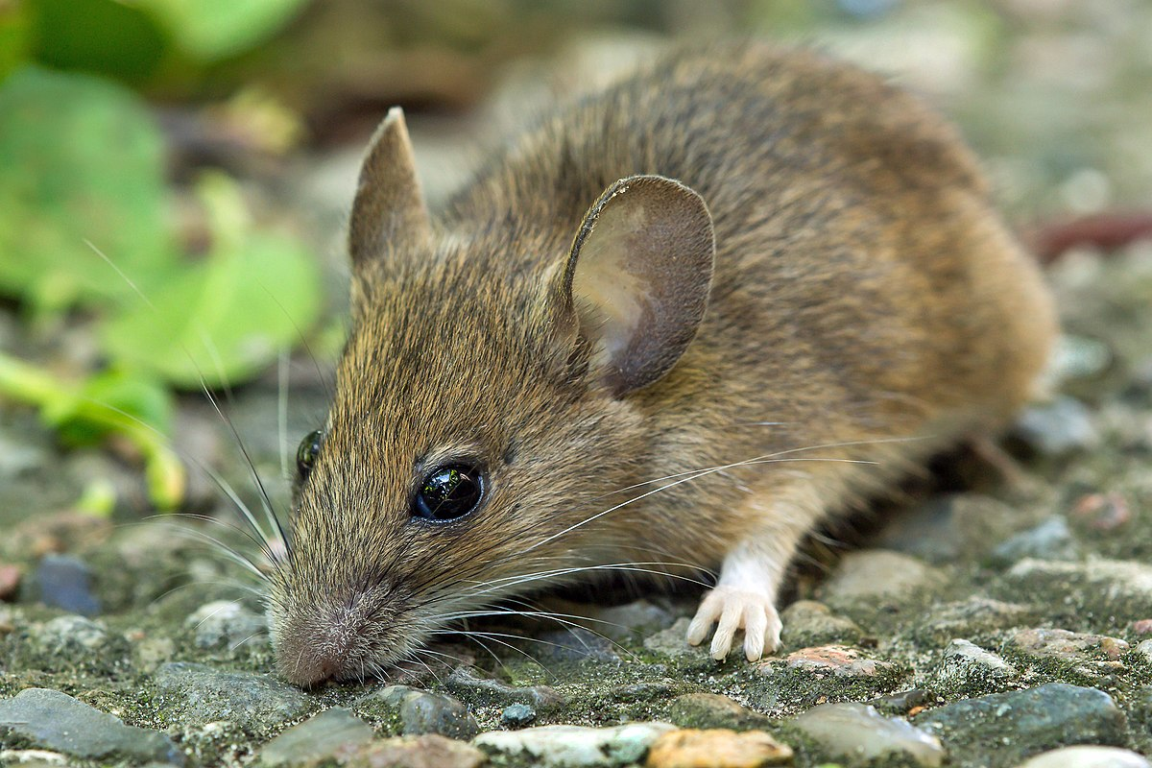
Synchrony and metapopulation dynamics
Synchrony of subpopulation dynamics important for persistence and probability of global extinction
Dispersal and environmental fluctuations (stochasticity) are important determinant of synchrony
(Heino et al. 1997 Proc Roy Soc B, Liebhold et al. 2004 Ann Rev Ecol Evol Syst)

Slide 30
A simple metapopulation growth rate model
Model assumptions
Density-independent dynamics
At each time step, all individuals:
- grow,
- reproduce,
- disperse,
- die.
Two subpopulations linked by dispersal,
- dispersing individuals leave from the centre of their natal patch
”Semelparity”
”Connectivity”
Prob. successful dispersal
Distance decay in connectivity
x
Patch spacing, x
Patch 1, width w
Patch 2, width w

Slide 31
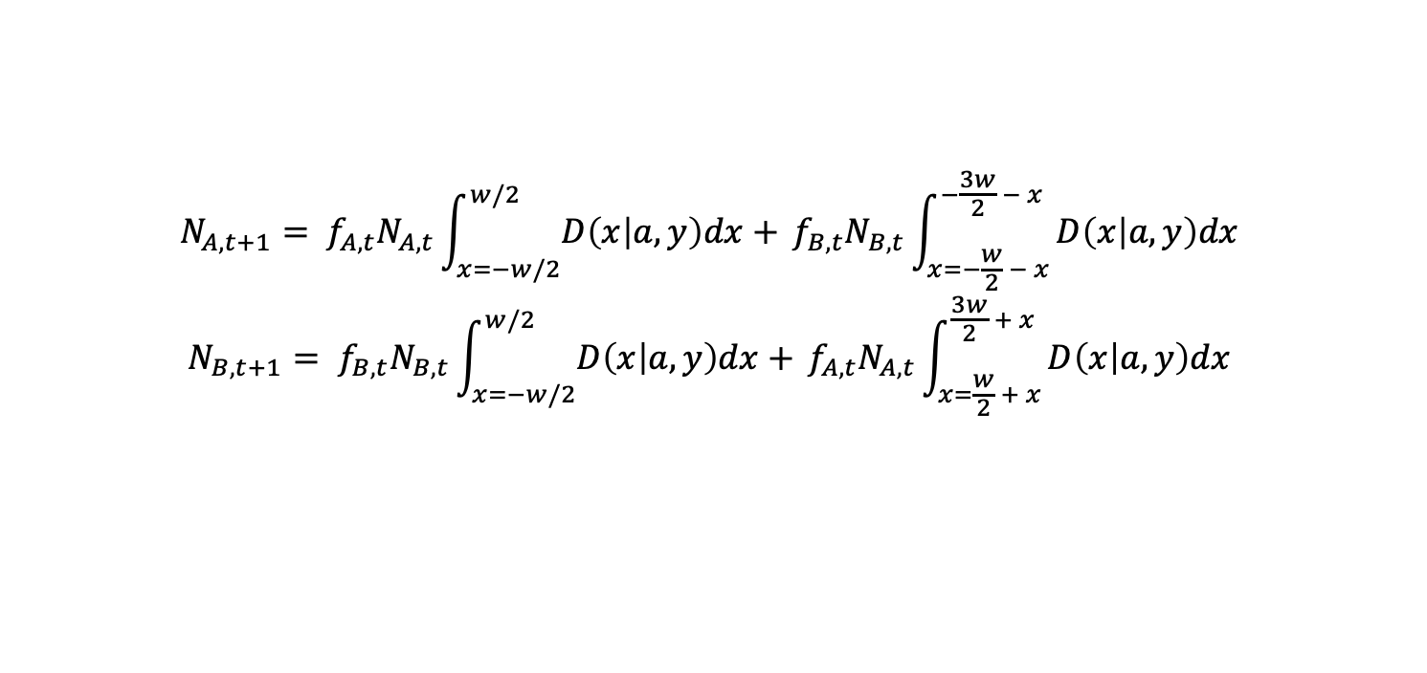
Connectivity versus risk-spreading
Correlation of per-capita fecundity
Distance decay in environmental covariance
Prob. successful dispersal
Distance decay in connectivity
x
x
Patch spacing, x
Patch A, width w
Patch B, width w
$$N_{A, t+1}= f_{A,t}N_{A,t}\int_{x=−w/2}^{w/2}{D\left(x | a,y\right)dx+ }f_{B,t}N_{B,t}\int_{x=−\frac{w}{2} − x}^{−\frac{3w}{2} − x}{D\left(x | a,y\right)dx }$$
$$N_{B, t+1}= f_{B,t}N_{B,t}\int_{x=−w/2}^{w/2}{D\left(x | a,y\right)dx+ }f_{A,t}N_{A,t}\int_{x=\frac{w}{2} + x}^{\frac{3w}{2} + x}{D\left(x | a,y\right)dx }$$
Blowes & Connolly 2012 Ecol Appl

Slide 32
Computer exercises
Metapopulation dynamics
Risk-spreading, connectivity, and optimal reserve spacing

